Slide 1

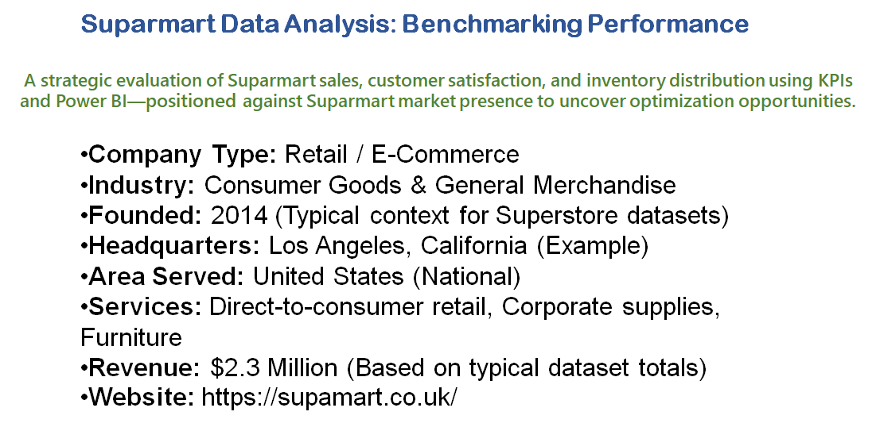

Slide 2
BUSINESS REQUIREMENT
KPI’s Requirements
1. Total Sales: The overall revenue generated from all items sold across all regions.
2. Total Profit: The net earnings after subtracting costs from revenue.
3. Total Quantity: The total count of individual units sold.
4. Average Discount: The average percentage deduction given on products.
5. Average Sales: The average revenue per transaction.

Slide 3
BUSINESS REQUIREMENT
Total Sales by Category
Objective: Analyze the impact of different product categories (Furniture, Technology, Office Supplies) on total sales.
Additional KPI Metrics: Assess how Profit and Quantity vary by Category.
Chart Type: Donut Chart
2. Total Sales by Sub-Category
Objective: Identify the performance of specific sub-categories (e.g., Phones, Chairs, Binders) in terms of revenue.
Additional KPI Metrics: Identify top 5 and bottom 5 performers.
Chart Type: Bar Chart

Slide 4
BUSINESS REQUIREMENT
5. Sales by Customer Segment
Objective: Analyze the contribution of different segments (Consumer, Corporate, Home Office) to total sales.
Chart Type: Pie Chart / Donut Chart.

